Slide 1
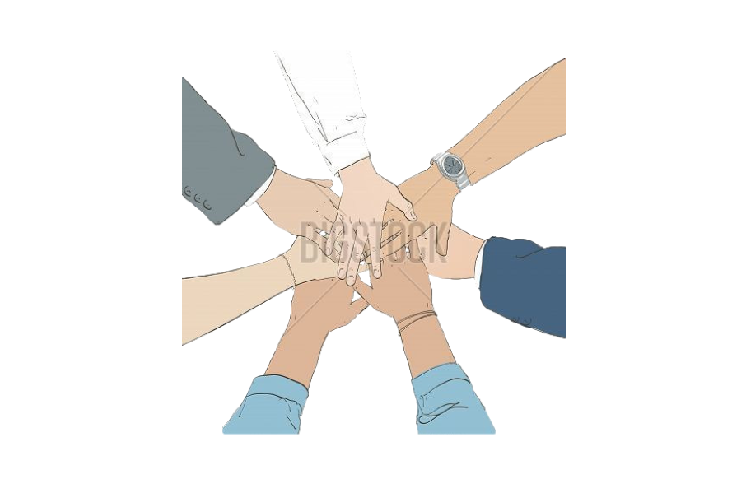
Join Hands
An app for house court social service
By Daniel & Kenny

Slide 2
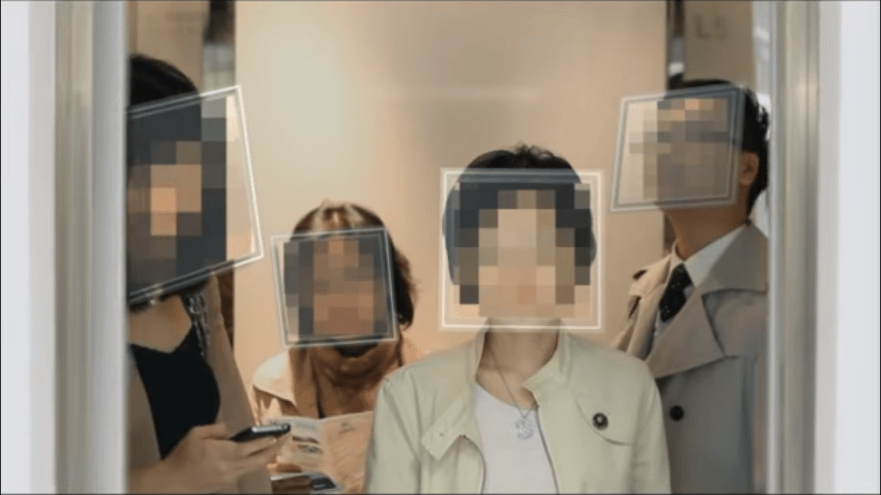
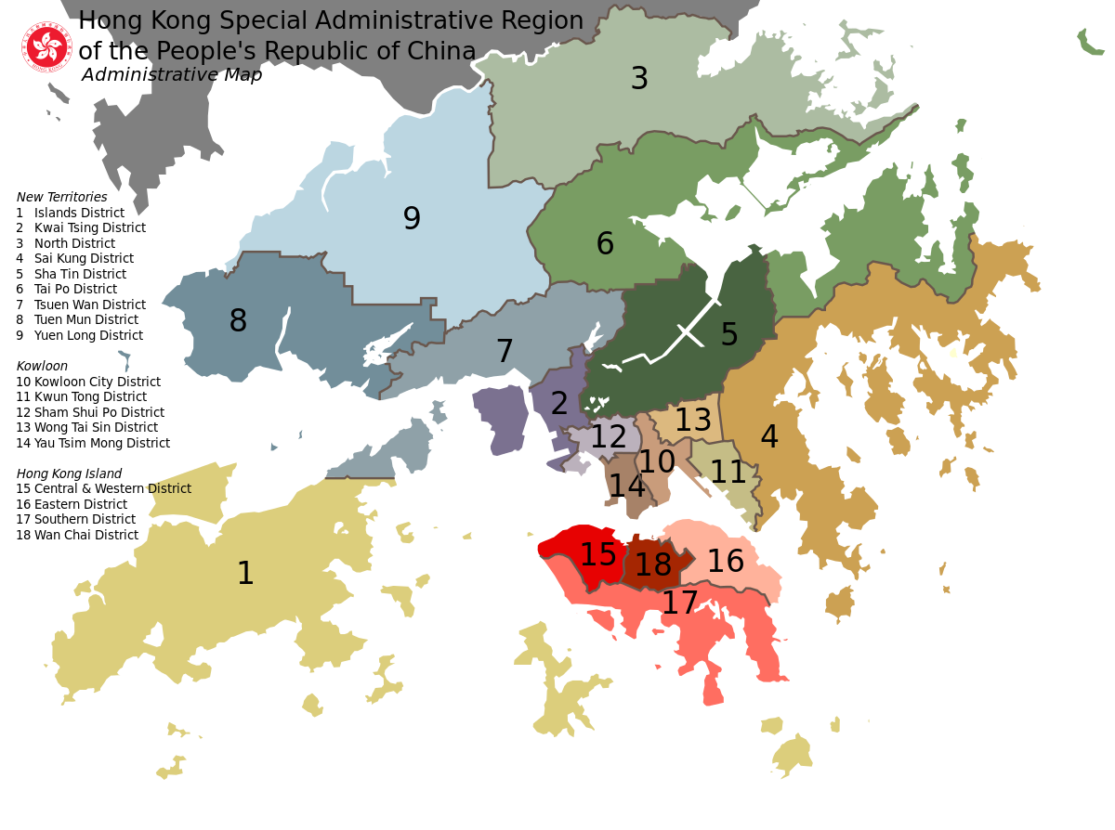
Problem
In the districts
“So close yet so far”
no direct way for citizens to know each other
Notes:
invisiable wall between each other
it is weird to talk with other people

Slide 3
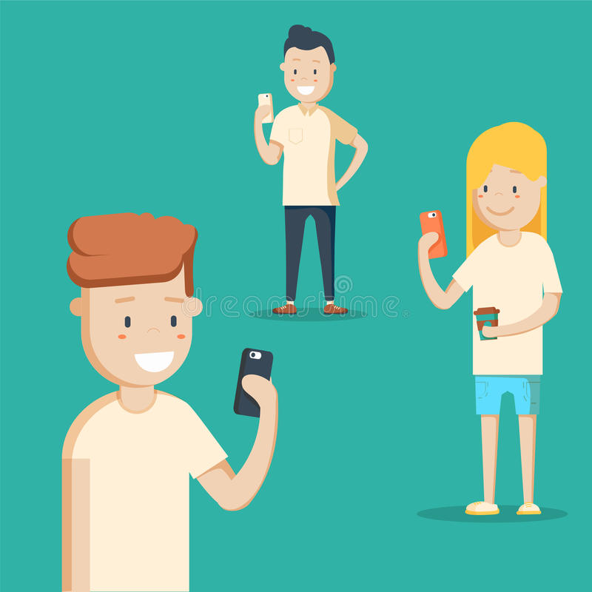
Our mission
Provide a tool
help people to rebuild the profound neighborhood as in the past
as a platform for the people to share news in the same districts

Slide 4
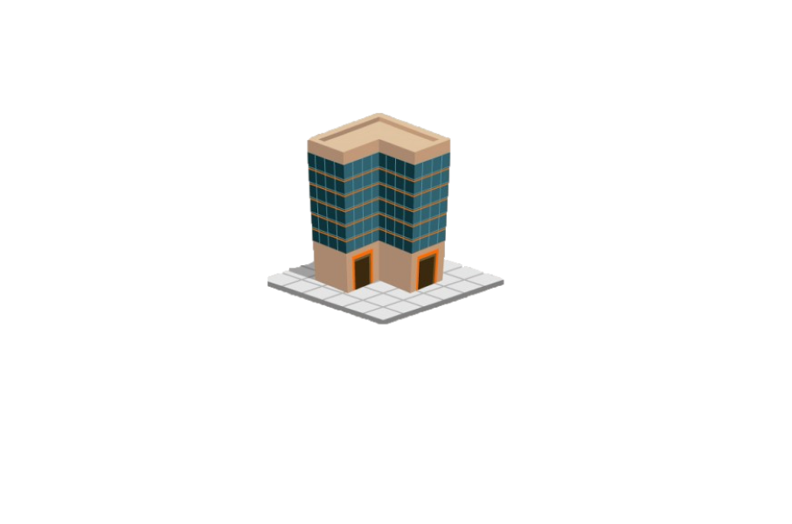
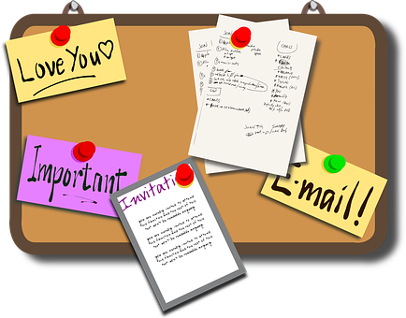
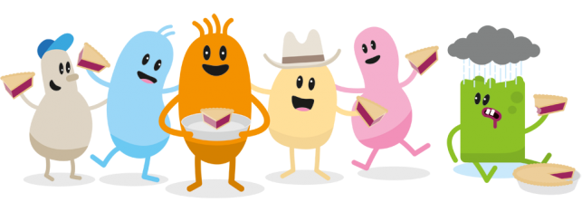


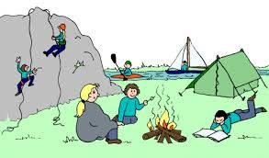
How “Join Hands” work
http://www.alternativesjournal.ca/science-and-solutions/ours-better-yours

Slide 5
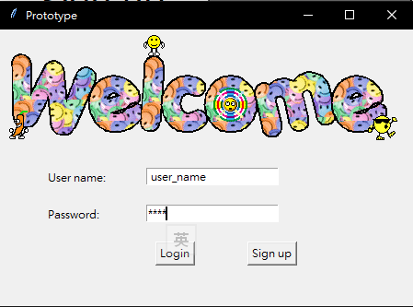
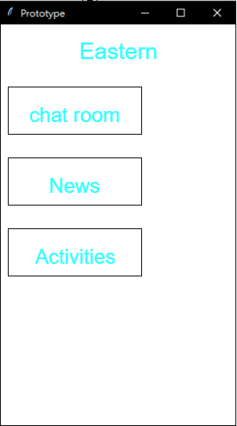
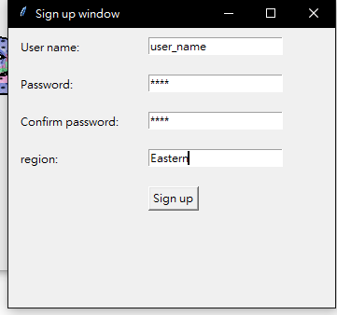
Product
sign up login main page

Slide 6
Product function
Chat room → chat with the people in same district
News → share the news in district
Activities → post the event monthly

Slide 7
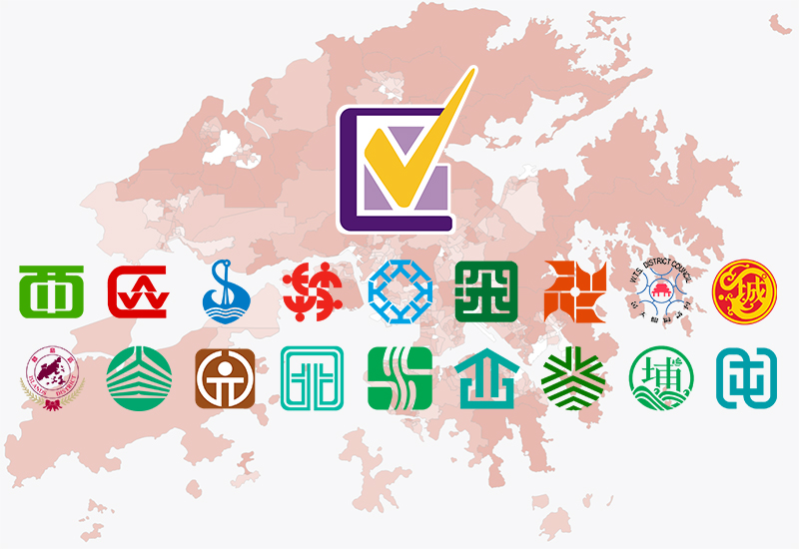

What we’re looking for...
Partnerships
Government
District Council
Discover Hong Kong

